Slide 1
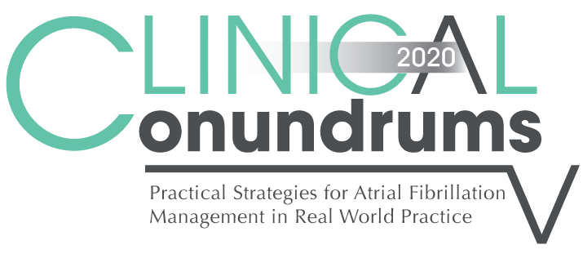






Case 8
CASE 5
Detection of AF: Methods, Challenges and Uncertainties
Notes:
Speaker Notes:
Atrial fibrillation (AF) is the most common arrhythmia, presently affecting approximately 3–6 million adult individuals in the US. Clinical research indicates a rising prevalence and incidence of AF, doubling the number of those affected in the next 25 years . Based on its clinical pattern, and primarily based on standard surface ECG recordings, it is characterized as: paroxysmal AF – (intermittent episodes, self-terminating at <7 days), persistent AF (requiring medical intervention for termination) and permanent AF (when normal rhythm cannot be sustained despite medical intervention).
With the progress in device technology, implantable pacemakers and defibrillators are capable of detecting atrial arrhythmias defined as atrial rates exceeding a programmable rate cutoff for programmable time duration. Verification of these detection algorithms has shown a high sensitivity and specificity. The stored information on these atrial arrhythmia episodes can then be displayed in multiple ways, i.e.: longest episode, hours per day, atrial arrhythmia burden (% time over a monitoring period).
In contrast to clinically documented paroxysmal AF, these device detected atrial arrhythmias are most often asymptomatic, short in duration and the atrial rhythm is often more organized. Thus a new clinical entity, referred to as subclinical atrial fibrillation (SCAF), has emerged. At this time its prognostic and therapeutic implications are uncertain.
AF is a well-established risk factor for stroke and current guidelines recommend chronic anticoagulation in patients with AF and additional risk factors. These recommendations are based on multiple randomized trials in patients with clinically documented and predominantly permanent AF. Several recent clinical trials in patients with implantable devices have investigated the prevalence of SCAF and its implications with regard to clinical outcomes such as stroke risk.
The patient populations studied, while typically elderly and with additional stroke risk factors such as hypertension and/or diabetes, were quite heterogeneous, with regard to severity of underlying heart disease, pre-existing AF and history of stroke as well as therapy with antiplatelet drugs and oral anticoagulation.
A common finding in these trials was that the device based arrhythmia detection algorithm identified patient groups with a “low AF burden” and those with a “high AF burden” based on a trial specified cutoff point. Furthermore, while the cutoff for low versus high AF burden varied between the trials (i.e., 5 min to 24 h), all trials showed a significant difference in annualized stroke rates between these two populations.
The absolute annual stroke risk was typically <1% in the “low AF burden” groups and ranged between 2% and 4% in the “high AF burden” groups. The ASSERT trial especially further noted an increase in annual stroke risk based on patient's CHADS2 score (CHADS2 = 1: 0.6% vs CHADS2 >2: 3.9%) and duration of SCAF (<17 h: 1.2% vs >17 h: 4.9%). This increased stroke risk is similar to that seen in patients with clinical, mostly permanent, AF and CHA2DS2-VASc score. For this latter risk group, current guidelines recommend chronic anticoagulation. In contrast, there are no data or consensus on the role of chronic anticoagulation in patients with a “high AF burden” on device interrogation; likewise the cut-point for “high” AF burden is not established.
While trials have shown similar stroke risk and benefit from anticoagulation therapy in patients with clinical paroxysmal versus permanent AF in these trials paroxysmal AF was typically defined as AF and normal heart rhythm documented on routine clinical ECG recordings. Whether a patient, with brief episodes of SCAF, benefits similarly from anticoagulation is not clear. While the benefit of anticoagulation in patients with SCAF is not established, chronic anticoagulation therapy will expose these patients to a significant risk of major bleeding complication with an annual incidence of 3%–3.5%.
Analyses of the temporal relationship between SCAF and stroke event seem to challenge a direct mechanistic role of SCAF. Among a combined 7700 patients, followed from 1.4 to 2.5 years, 169 thromboembolic events (mostly strokes) occurred. Approximately half of those patients did not have any SCAF documented on their device throughout the study period, suggesting a likely atherosclerotic vascular disease etiology of the stroke. Only 10%–35% of stroke victims with any documented SCAF, had it recorded within 30 days prior to the stroke event, challenging some of the current concepts of AF mediated stroke mechanism.
The only randomized trial addressing the issue of SCAF, stroke and anticoagulation is ongoing (ARTESiA; NCT01938248). In this trial, patients with device detected SCAF >6 min but <24 h and a CHA2DS2-VASc score >4 are being randomized to therapy with aspirin or apixaban. The goal is to enroll 4000 patients and results are expected in 2019.
In the meantime the clinical approach to patients with SCAF remains challenging. Aggressive management of contributing stroke risk factors such as hypertension and diabetes, as well as guideline based therapy with antiplatelet drugs and statin therapy is mandatory. Furthermore, close clinical monitoring, ideally combined with remote device monitoring and, if available, enabled AF alert features, is required to detect progression of AF burden. Based on limited data it seems reasonable to consider use of oral anticoagulation in patients with SCAF >24 h, especially in those with a CHADS2 score >2 and a low bleeding risk.
Atrial fibrillation (AF) is a rapidly growing public health and economic burden. The global number of individuals with clinically diagnosed AF was estimated to be 33 million in 2010 and is expected to double by 2050 as a result of demographic changes and the rising prevalence of risk factors for AF such as obesity, diabetes mellitus, and hypertension. AF is associated with substantial morbidity and mortality (mostly secondary to an increased risk of stroke), reduced quality of life, and considerable costs. However, these figures are likely to underestimate the true prevalence of AF; prolonged electrocardiographic monitoring detects clinically silent subclinical AF (SCAF) in a variable proportion of subjects presenting in sinus rhythm, depending on the type and duration of monitoring, the characteristics of the study population (in particular, age and medical history), and the definition of AF. SCAF could have a significant impact on health and disability in that it may be linked to a significant proportion of strokes of undetermined origin. In this regard, patients with an implanted cardiac device (eg, pacemaker or defibrillator) that includes an atrial lead have provided novel data on the prevalence and potential clinical significance of atrial high-rate episodes (AHREs), which largely represent SCAF (but may also include artifacts, atrial flutter, or reentrant supraventricular tachycardia). In particular, in the ASSERT study (Asymptomatic AF and Stroke Evaluation in Pacemaker Patients and the AF Reduction Atrial Pacing Trial), continuous electrocardiographic recording for 3 months by an implanted pacemaker (n=2451) or defibrillator (n=129) identified episodes of AHRE (defined as rapid atrial rate >190 bpm lasting >6 minutes) in 10% of patients (mean age, ≈76 years) who were in sinus rhythm and had no history of AF. Compared with sinus rhythm, the presence of AHRE was associated with a hazard ratio for stroke and embolic events of 2.5 (95% confidence interval, 1.3–4.9; P=0.007) over a 2.5-year follow-up period. Although the prevalence of AHRE suggests that clinical AF may be just the tip of a large submerged iceberg of undiagnosed AF in the general population, it is possible that the medical conditions that resulted in implantation of a cardiac device were also driving the high rate of atrial arrhythmias in these patients. Similar concerns apply to evidence indicating that prolonged cardiac monitoring in patients who have experienced cryptogenic stroke reveals a high prevalence of SCAF.

Slide 2

Learning Objectives
Upon completion of this activity, participants should be able to:
I
Apply different screening tools for excluding or diagnosing AF in the office setting
II
Describe the prevalence and risks for SCAF and identify screening strategies
III
Implement appropriate treatment strategies individualized to the patient’s characteristics

Slide 3

Case 8
Winnie
72 years old
Winnie presents to your office for her annual check-up.
She tells you that she had palpitations a week or so ago but she is currently asymptomatic
Notes:
Speaker Notes:
Palpitations represent one of the most commonly encountered symptoms by primary care physicians. Palpitations can be completely benign or abnormal depending on the clinical scenario. In patients with palpitations that remain unexplained after initial evaluation with routine ECG, cardiac monitoring should be considered.
Subclinical atrial fibrillation (SCAF) is a term used to describe short-lasting (minutes to hours), asymptomatic atrial fibrillation (AF) detected by long-term continuous monitoring, typically using an implanted pacemaker, defibrillator, or cardiac monitor.
Both the TRENDS (The Relationship Between Daily Atrial Tachyarrhythmia Burden from Implantable Device Diagnostics and Stroke Risk) and ASSERT (Asymptomatic Atrial Fibrillation and Stroke Evaluation in Pacemaker Patients and the Atrial Fibrillation Reduction Atrial Pacing Trial) studies have shown that SCAF is associated with an increased risk of stroke. However, unlike clinical AF in which stroke risk is increased 4–5 times, for SCAF the risk is only 2–2.5 times increased, and the absolute risk of stroke observed in these studies was much lower than expected based on the subjects’ CHADS-2 score.
The use of oral anticoagulants to treat patients with SCAF is controversial and is the subject of 2 ongoing clinical trials: ARTESiA (Apixaban for the Reduction of Thrombo-Embolism in Patients With Device-Detected Sub-Clinical Atrial Fibrillation) and NOAH-AFNET-6 (Non-vitamin K antagonist Oral anticoagulants in patients with Atrial High rate episodes).
Why detect sub-clinical AF?
Important for clinical care and for research
Identify an important risk factor for stroke
– Pacemaker/ICD patients; general population
– Likely very prevalent (i.e. elderly)
– Likely very treatable
Clarify the relationship between AF and stroke Help to interpret the results of clinical trials for patients with AF
– Rate vs. rhythm; catheter ablation

Slide 4

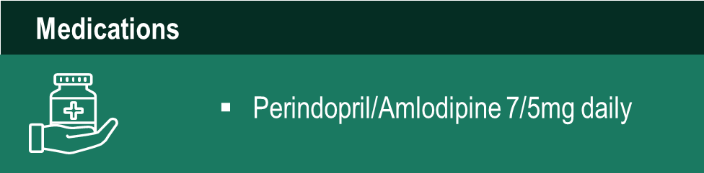
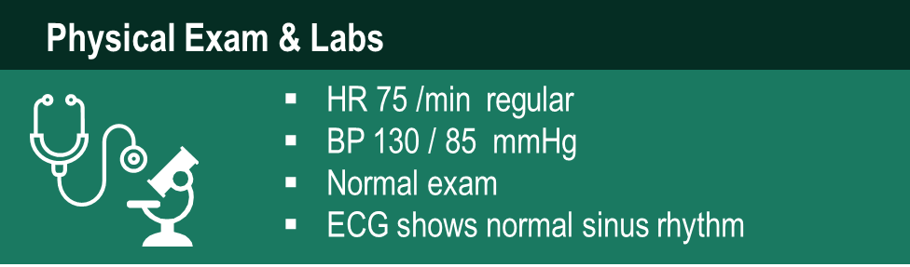
Case 8
Winnie
72 years old
Notes:
Speaker Notes:
Hand held ECG Recorders: Will allow a patient to record the ECG while having symptoms – patients apply the recoding device , and usually requires 30 sec or more of symptoms to be practically useful.
Options 2-4: These are excellent options which provide prolonged, continuous ECG monitoring for arrhythmias including AF over longer periods of time such as 24 hours – 14 days or longer in case of an ILR . The best option depends on the frequency of symptoms. For example, symptoms every 2 weeks are not likley to be captured on a 24-48 hr, Holter monitor Practically speaking implantable monitoring device would not be considered at this point in time for a patient presenting similarly to Winnie.

Slide 5
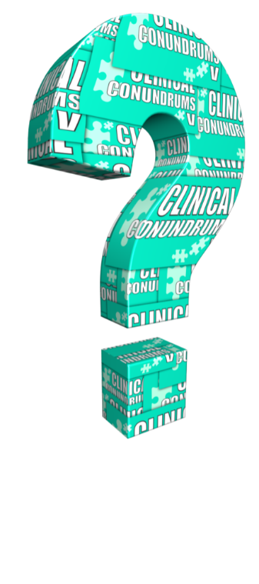
What are your options, besides physical exam and ECG, for evaluating Winnie’s palpitations and excluding AF?
Select from one or more of the available options
Handheld ECG recorder –for office or home use (e.g. Kardia Mobile or HeartCheck CardiBeat ECG)
Holter monitor
Loop recorder eg Cardio Memo
Implantable monitoring device –ILR (e.g. Reveal)
None of the above

Slide 6

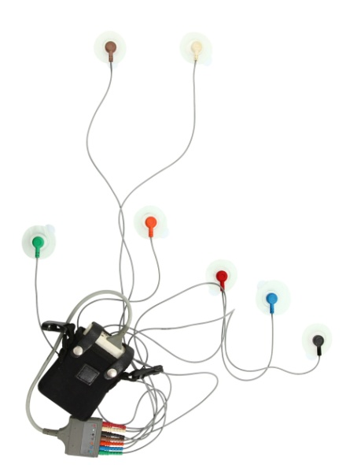
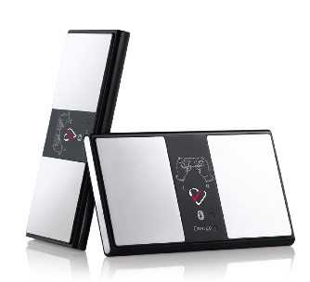
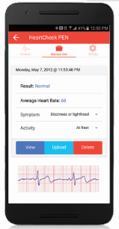
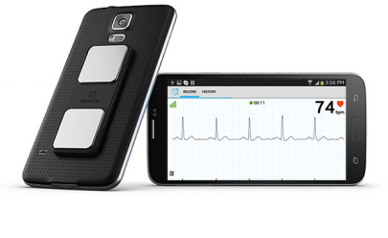
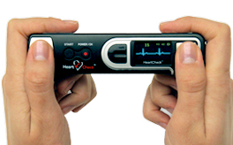
Different Screening Tools
Physical Exam
Holter (24-72 hrs)
Personal Use Devices
Notes:
Speaker Notes:
Kardia Mobile by AliveCor®
Patient (or physician activated)
Up to 30 second single lead recording from fingers placed on metal electrode plates that can also record when applied directly to the chest
Automatic AF detection
Remote tracing analysis
Transmission of tracing with simultaneous voice recording by email
HeartCheck by CardioComm
Patient (or physician activated)
Up to 30 second single lead recording from fingers placed on metal electrode plates that can also record when applied directly to the chest
Remote tracing analysis
Transmission of tracing with notes by secure data transmission (not email)

Slide 7
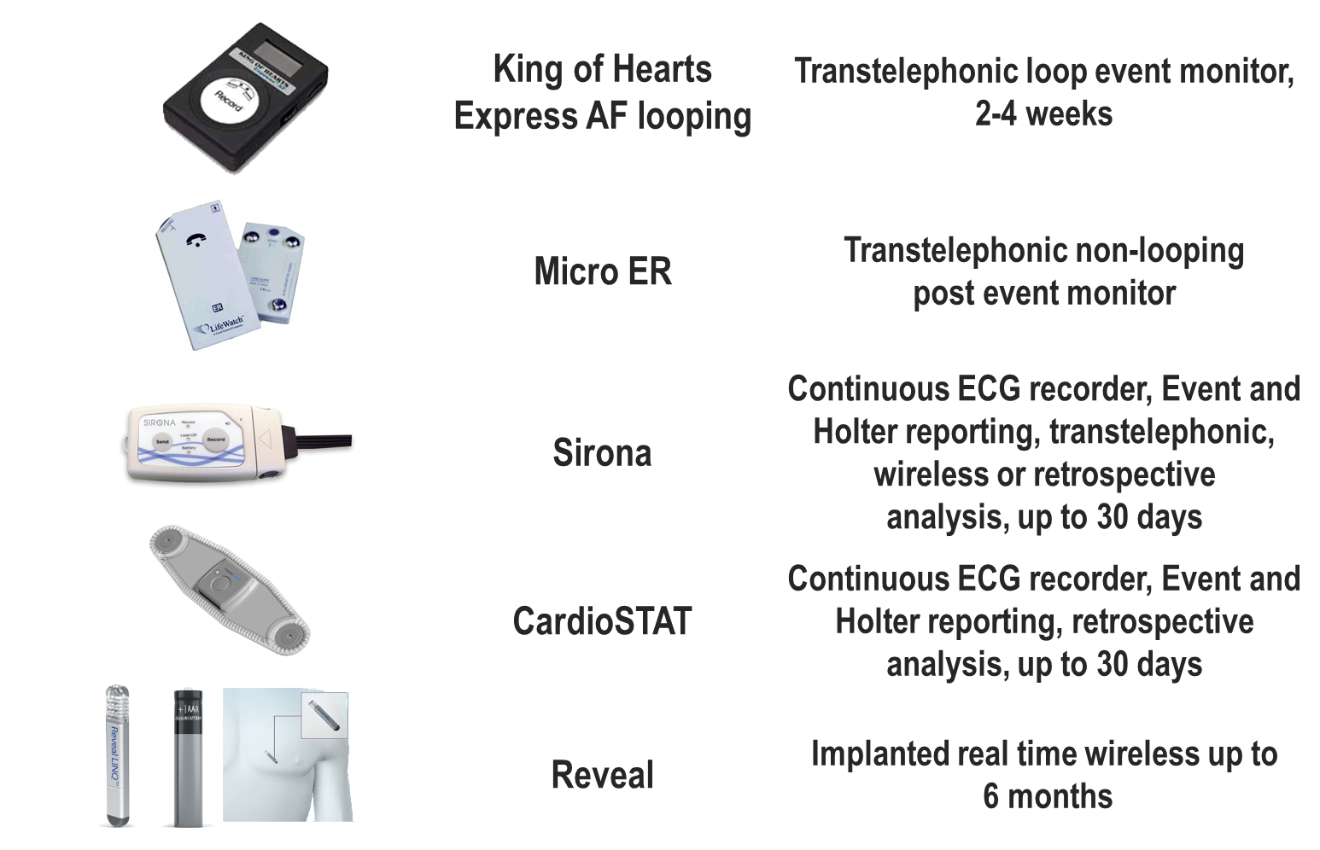
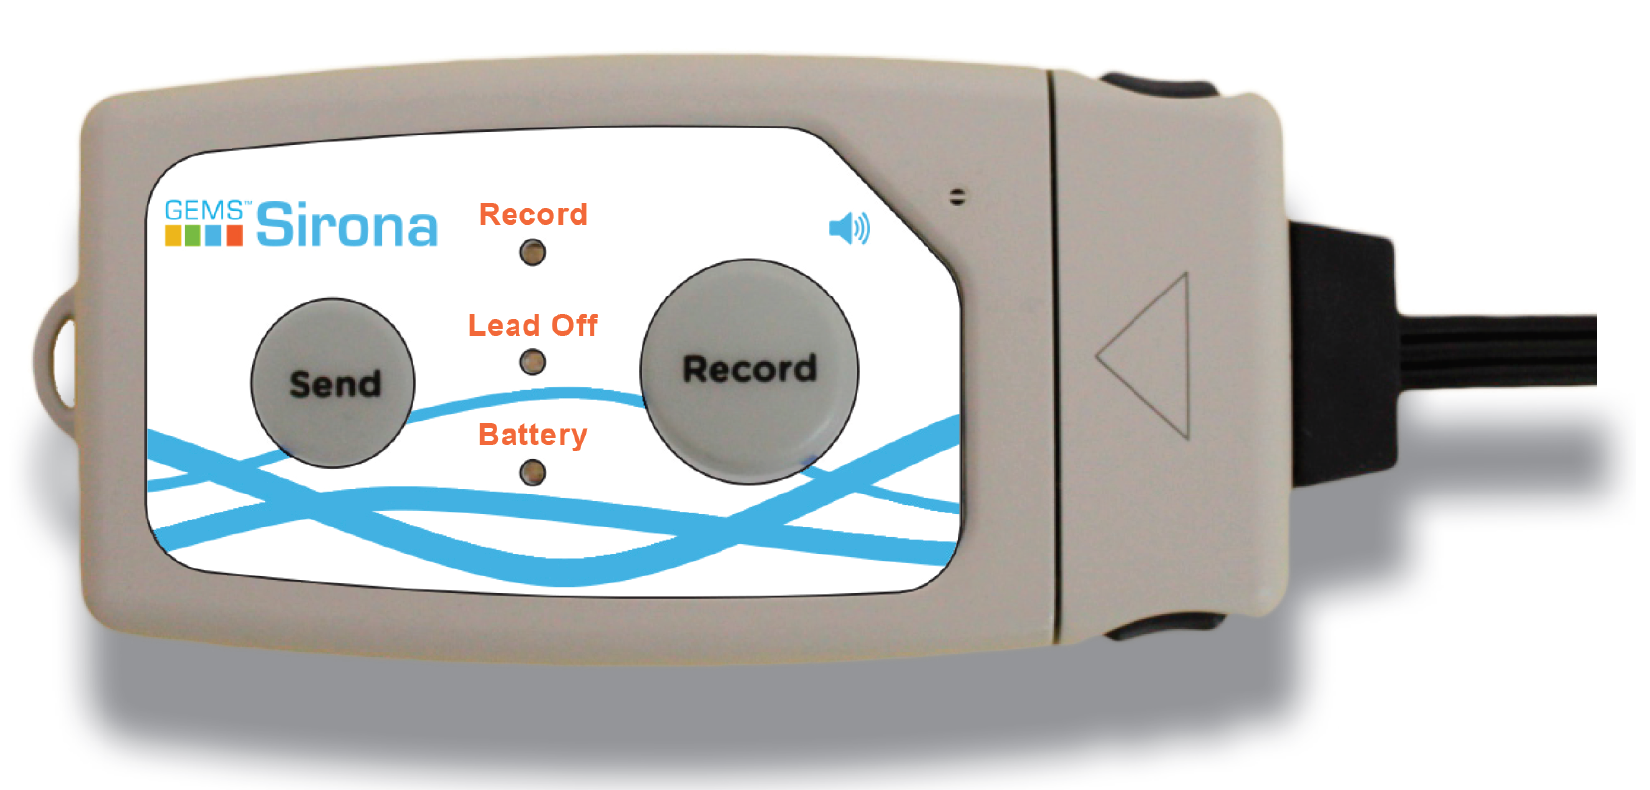

Different Screening Tools
Notes:
Speaker Notes:
CardioMemo and King of Heart NO LONGER MANUFACTURED –COST $1200 – NOT LISTED AS AN APPROVED A MEDICAL DEVICE FOR SALE BY HEALTH CANADA
Usually provided to patient for 2-4 weeks
Two electrodes applied to chest, replaced daily
Symptom activated by patient by pressing the “Rec” button
Automatic AF detection algorithm (“Express AF” version)
Transmission by phone
Micro ER – Listed by Health Canada
Non looping symptomatic event monitor
No chest electrodes required
Patient activated recordings of =< 32 seconds each
Maximum six recordings allowed by device memory before downloading required
Sirona ($1,500) – Listed by Health Canada
Continuous ECG monitor for up to 30 days
One to three lead ECG
H2O resistant device
Patient triggered event button
Auto detection of arrhythmias such as AF
Real time Event transmission via Bluetooth
Transtelephonic ECG transmission
Remote monitoring software in several Canadian Hospitals
CardioSTAT ($425) – Listed for sale by Health Canada
H2O resistant patch
Continuous ECG recording up to 7 days
Patient triggered event button
Reveal XT or LINK ($4000) - Listed for sale by Health Canada
Implantable cardiac monitor
Implanted into the chest subcutaneously
Battery lasts up to three years
Auto transmission of events

Slide 8


Would YOU prescribe a DOAC to Winnie if AF was detected x 30 sec with a Mobile ECG device
(Kardia, HeartCheck or equivalent)
Notes:
Speaker Notes:
These questions are meant to engage the audience and evaluate what the audience would do in the described scenario

Slide 9
Would YOU prescribe a DOAC to Winnie if SCAF was detected with an insertable cardiac monitor (ICM) (e.g. “REVEAL”) if longest episode of AF was 1 hour?
Notes:
Speaker Notes:
These questions are meant to engage the audience and evaluate what the audience would do in the described scenario

Slide 10
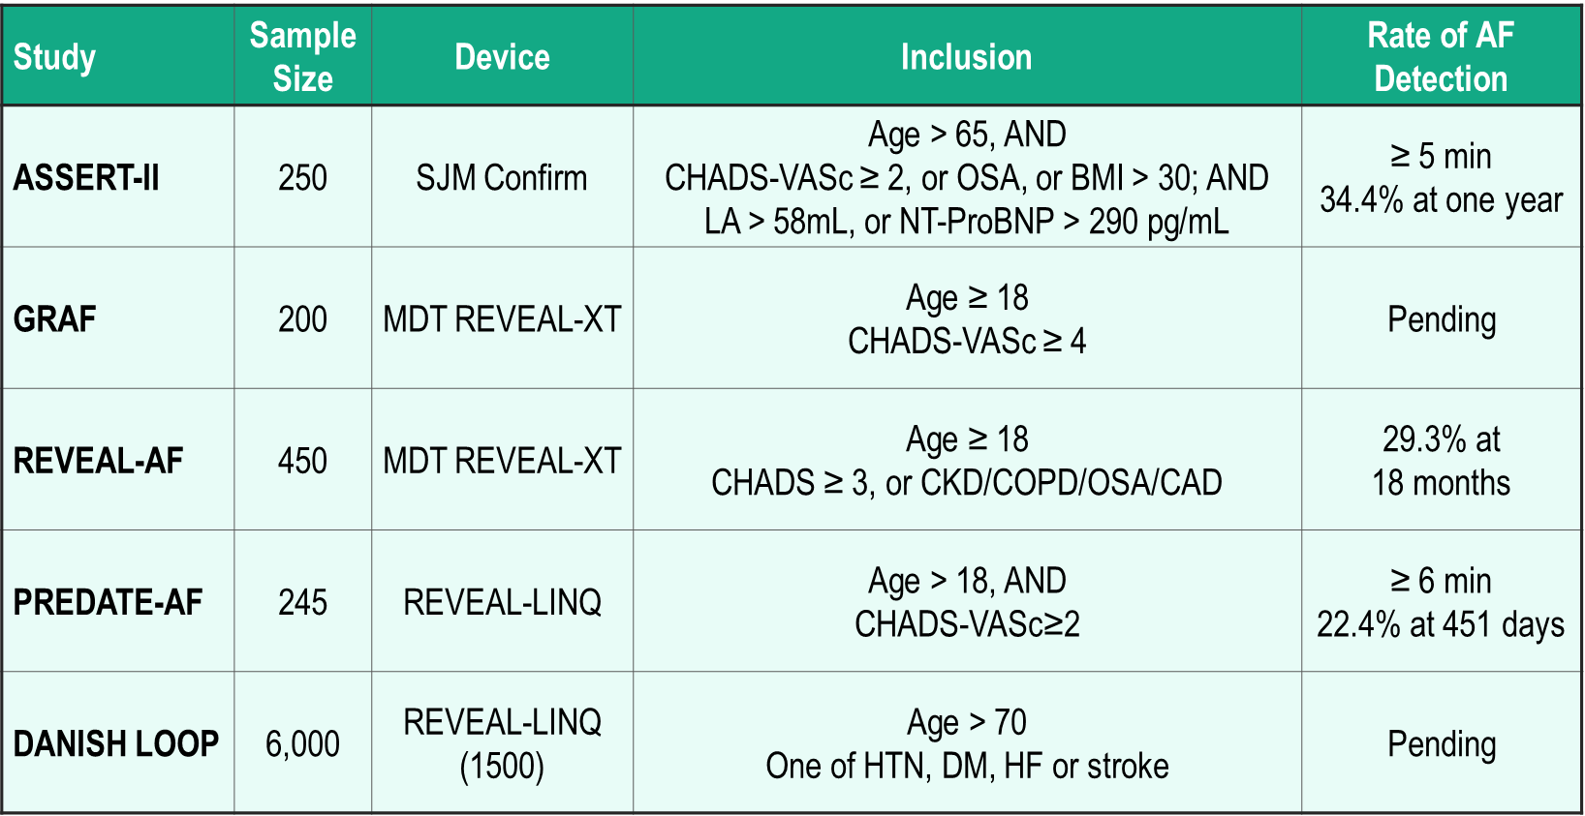
Is SCAF Common?
ASSERT: Van Gelder IC, et al. Eur Heart J 2017; 38(17):1339-1344.
Notes:
Speaker Notes:
Emerging data reveal that SCAF is very common in high-risk elderly patients, and although usually infrequent and short-lasting, it often precedes clinical AF. The clinical significance and optimal management of SCAF are largely unknown; in particular, further studies are needed to determine whether SCAF is a potentially treatable risk factor, an accessible biomarker, or indeed both.
SCAF is a common entity, not only in patients with implanted pacemakers and defibrillators but also in 30%–35% of older individuals with cardiovascular conditions. Thromboembolic risk increases in the presence of atrial arrhythmias as short as 20 beats in duration. However, this risk goes up with increasing burden of AF, even with progression from paroxysmal to persistent to permanent clinical AF. Among patients with SCAF, only 24% of individuals progress to episodes >23 hours over 2.4 years, and it is these individuals who seem to have the greatest risk of adverse outcomes.
Clinically silent AF was detected in 34% of patients within 1 year (mean total follow up, 16 months) and LAE, but not prior stroke or TIA, was found to be a predictor of incident AF. These data suggest that there is a significant burden of subclinical AF in individuals with higher CHA₂DS₂-Vasc scores and perhaps this risk assessment tool (in addition to presence of LAE) should be used to decide which individuals to screen more aggressively for AF with implantable monitors.
The absence of a relationship between prior stroke and incident AF is incompletely understood but may suggest a complex, only partially causal relationship between stroke and AF. The implications for anticoagulation therapy (with the new oral agents) for management of subclinical AF are not yet well understood and there are ongoing randomized trials to determine whether anticoagulation is indicated (ARTESiA). There are also ongoing randomized trials, soon to report, that are screening patients for subclinical AF without left atrial enlargement (LAE). Regardless, the latest easily implanted cardiac monitors have uncovered a whole new disease entity (subclinical AF), which we are still trying to understand how to manage.
In patients with implanted pacemakers and defibrillators, prior studies have established that subclinical atrial fibrillation (SCAF) lasting at least 5 minutes in duration is very common and is associated with an increased risk of stroke. • The results of the ASSERT-II trial (Prevalence of Subclinical Atrial Fibrillation Using an Implantable Cardiac Monitor) now demonstrate that this finding is not unique to patients with implanted pacemakers and defibrillators but is similarly common among individuals ≥65 years of age who have cardiovascular and stroke risk factors.
SCAF is common not only in patients with pacemakers, but more broadly in elderly individuals, affecting possibly 25-30% of all individuals > 65 years of age.
SCAF is different from typical, clinical AF with a lower stroke risk (approximately half) for any CHADS2 score. Ongoing trials will define the role of oral anticoagulation of SCAF according to level of stroke risk.

Slide 11
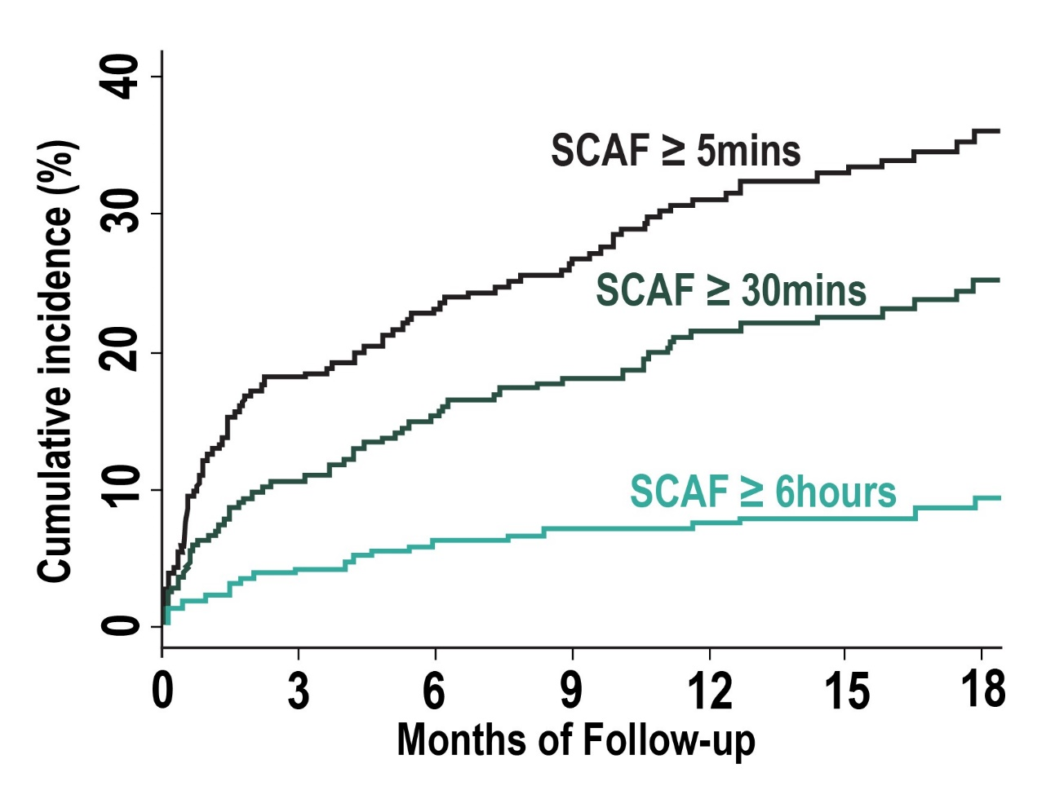
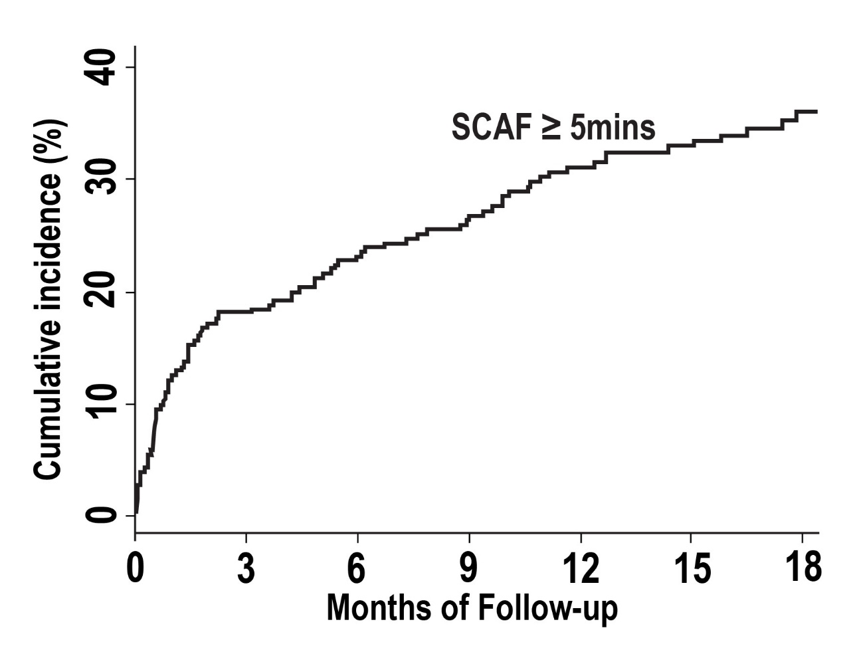
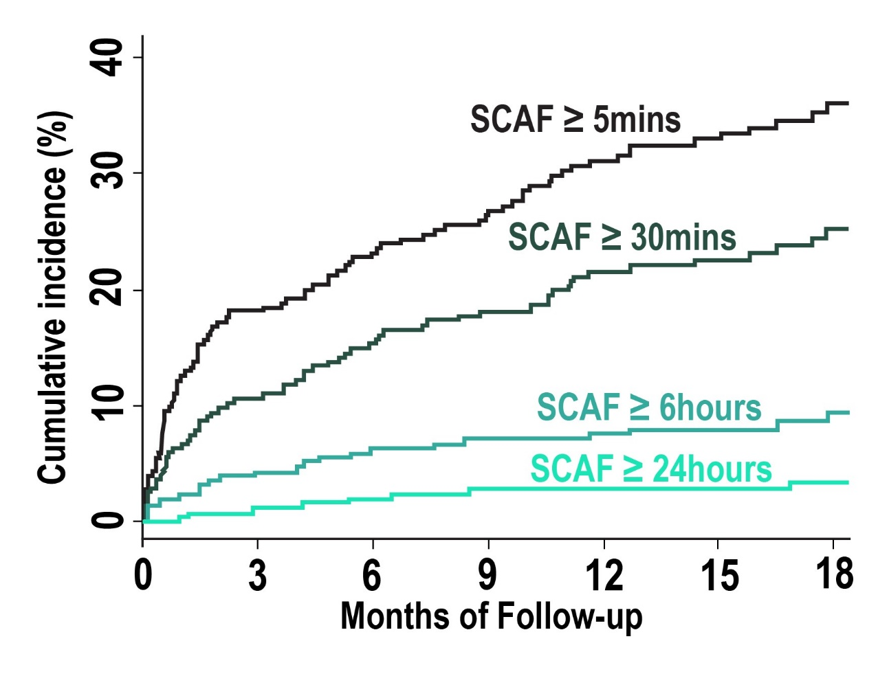
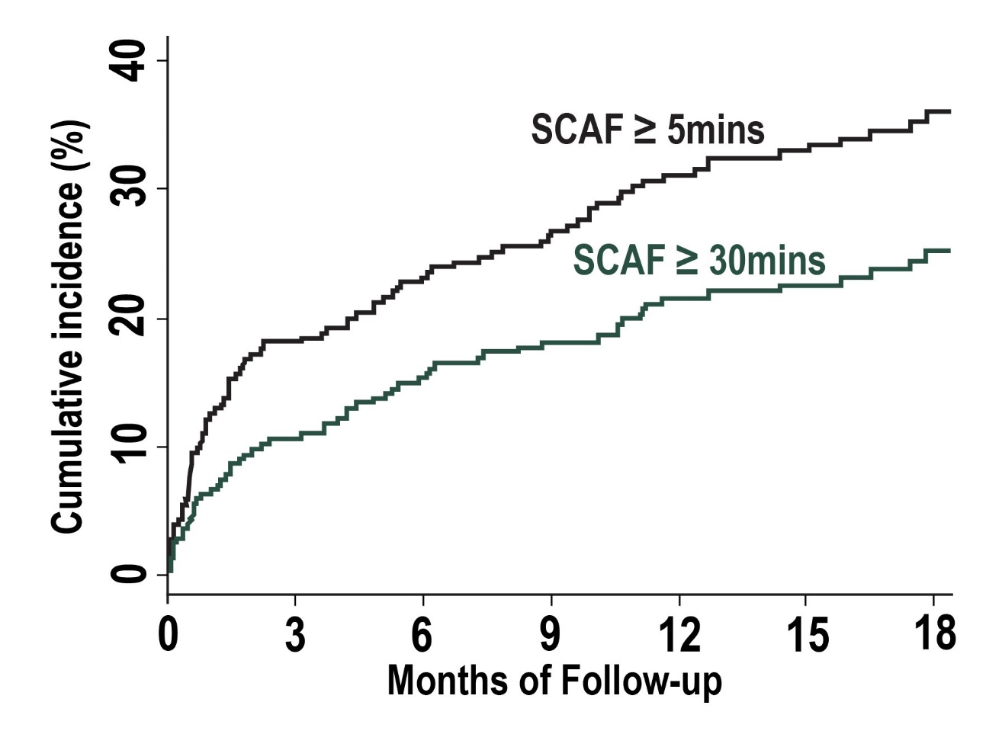
ASSERT-II: Incidence of SCAF
34.4% (27.7% – 42.3%)
21.8% (16.7% – 27.8%)
7.1% (4.5% – 10.6%)
2.7% (1.2% – 5.0%)
Healey JS, et al. Circulation 2017; 136(14):1276-1283..
Notes:
Speaker Notes:
The average follow-up was 16.3±3.8 months; 98.4% completed the minimum 9 months of monitoring, and 65% of patients completed 18 months, giving a total of 347.1 person-years of follow-up. SCAF ≥5 minutes occurred at an incidence rate of 34.4% per person-year (95% CI, 27.7–42.3), with Kaplan-Meier cumulative incidence at 12 months of 31.0%. In patients with SCAF ≥5 minutes, the median number of SCAF episodes was 6.5 (IQR, 1–24), the median duration of the longest SCAF episode was 62 minutes (IQR, 24–401 minutes), and the median weekly burden of SCAF was 3.4 minutes (IQR, 0.6–20 minutes). The rate of detection of SCAF ≥30 minutes was 21.8%/y (95% CI, 16.7– 27.8); ≥6 hours, 7.1%/y (95% CI, 4.5–10.6); and ≥24 hours, 2.7%/y (95% CI, 1.2–5.0). Of the 90 patients in whom SCAF ≥5 minutes was detected, 34% were detected in the first 30 days, 64% within the first 6 months, and 87% within the first year. The mean time from ICM insertion to the detection of SCAF ≥5 minutes was 5.1±5.5 months. In addition to SCAF, clinical AF or atrial flutter was detected by conventional surface electrocardiographic methods in 26 patients, with an annual rate of 7.9%/y. Of the patients with clinically detected AF or atrial flutter, 18 (69%) of them had SCAF detected before clinical AF a median of 82.5 days (IQR, 2–250 days) earlier. Patients in whom SCAF was detected were older, had a larger left atrial diameter, and had a lower systolic blood pressure and prevalence of heart failure and diabetes mellitus. There were no differences between those with and without SCAF detected in the baseline prevalence of prior stroke, resting sinus rate, CHA2 DS2 -VASc score, or serum NT-proBNP or troponin levels.
What does ASSERT-2 add to our understanding of SCAF?
First, it confirms that SCAF is common in high risk elderly patients without a pacemaker or defibrillator and that risk factors known to predict clinical AF (such as age and left atrial size) also predict SCAF. This is consistent with clinical AF and SCAF being part of the same spectrum and in keeping with the recently reported findings from the REVEAL AF study (Incidence of AF in High Risk Patients), in which the rate of detection of SCAF episodes lasting ≥6 minutes in a similar high-risk elderly population was 29.3% at the 18-month follow up, increasing to 40% by 30 months.
Second, these data imply that, at least in this age group, the majority of patients experience SCAF before a diagnosis of clinical AF is made.

Slide 12
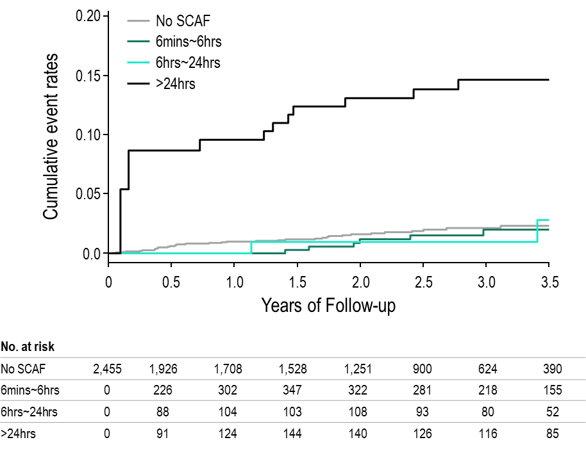
Risk of Stroke/SE
According to Duration of SCAF
Stroke risk in ASSERT is seen mostly for patients with SCAF lasting > 24 hours.
In them, the risk is approx. 5% per year – similar to clinical AF.
ASSERT: Van Gelder IC, et al. Eur Heart J 2017; 38(17):1339-1344.
Notes:
Speaker Notes:
BACKGROUND:
ASSERT demonstrated that subclinical atrial fibrillation (SCAF) is common in pacemaker patients without prior AF and is associated with increased risk of ischemic stroke or systemic embolism. SCAF episodes vary in duration and little is known about the incidence of different durations of SCAF, or their prognosis.
METHODS AND RESULTS:
ASSERT followed 2580 patients receiving a pacemaker or ICD, aged >65 years with hypertension, without prior AF. The effect of SCAF duration on subsequent risk of ischemic stroke or embolism was evaluated with time-dependent covariate Cox models. Patients in whom the longest SCAF was ≤6 min were excluded from the analysis (n=125). Among 2455 patients during mean follow-up of 2.5 years, the longest single episode of SCAF lasted >6 min to 6 h in 462 patients (18.8%), >6-24 h in 169 (6.9%), and >24 h in 262 (10.7%). SCAF duration >24 h was associated with a significant increased risk of subsequent stroke or systemic embolism (adjusted hazard ratio [HR] 3.24, 95% confidence interval [CI] 1.51-6.95, P=0.003). The risk of ischemic stroke or systemic embolism in patients with SCAF between 6 min and 24 h was not significantly different from patients without SCAF.
CONCLUSIONS:
SCAF >24 h is associated with an increased risk of ischemic stroke or systemic embolism

Slide 13

Case 8
Priya
67 years old
Priya presents to your office for a routine check-up.
Notes:
Speaker Notes:

Slide 14


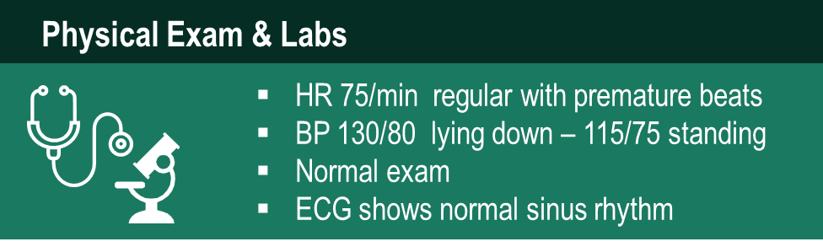
Case 8
Priya
67 years old
Notes:
Speaker Notes:

Slide 15
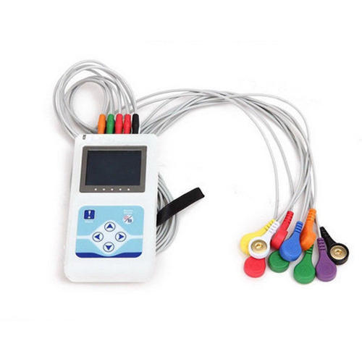
Case 8
Priya
67 years old
You order 24 hour Holter monitoring
500 APBs / day
3 runs of irregular atrial tachycardia at 135/min
Longest episode is 2 mins
Notes:
Speaker Notes:

Slide 16
Would YOU prescribe a DOAC to Priya based on her 24hr Holter findings?
Notes:
Speaker Notes:
These questions are meant to engage the audience and evaluate what the audience would do in the described scenario

Slide 17

Case 8
Ethel
83 years old
Ethel had a stroke recently with moderate neurological deficit.
She is otherwise asymptomatic with no history of palpitations.
Notes:
Speaker Notes:

Slide 18

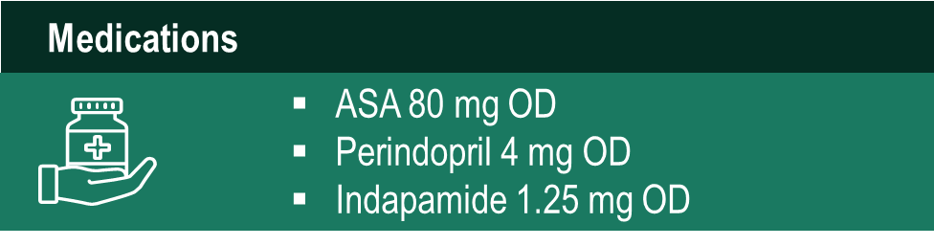
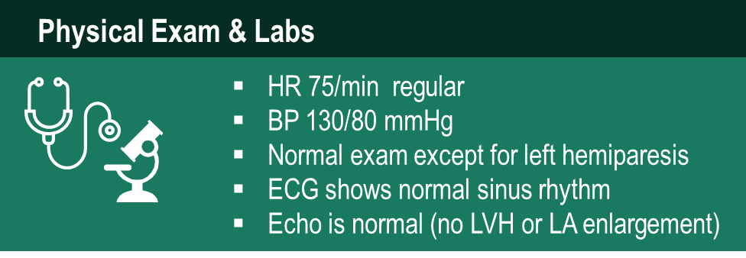
Case 8
Ethel
83 years old
Notes:
Speaker Notes:

Slide 19
Case 8
Ethel
83 years old
MRI
Embolic stroke pattern
24 hr HOLTER
750 APBs / day
No runs of atrial tachycardia or AF
Notes:
Speaker Notes:

Slide 20
Would YOU prescribe a DOAC to Ethel post stroke which was deemed “cryptogenic” following initial in-hospital investigation?
Notes:
Speaker Notes:
These questions are meant to engage the audience and evaluate what the audience would do in the described scenario

Slide 21
SCAF Detection for Cryptogenic Stroke
Incidence of cryptogenic stroke: 25-40% of strokes
Detection rates of SCAF in cryptogenic stroke: 0-25%
SCAF detection strategies:
In-hospital monitoring (e.g. scope, telemetry, Holter)
Serial ECGs
Outpatient Holter monitoring (24h, 48h, serial)
External loop recorders (eg. King of Heart)
Long-term outpatient monitoring (eg. CardioSTAT, Sirona)
Insertable cardiac monitors (ICMs) (eg. Reveal)
SCAF = Subclinical atrial fibrillation
Gladstone DJ, Spring M, Dorian P, Panzov V, Thorpe KE, Hall J, et al.
N Engl J Med 2014; 370:2467-2477.
Notes:
Speaker Notes:
In the presence of a cryptogenic stroke, SCAF prevalence of up to 30% in 3 years can be recorded by an ICM. While there is no randomized data, most would consider the use of oral anticoagulation instead of aspirin therapy in secondary prevention for recurrent stroke , if SCAF is identified.
If no AF is identified, recent RCTs show no benefit of oral anticoagulation .
More controversy centres about SCAF recorded by implanted CIEDs.
Recorded SCAFs predicted clinical AF. However, recorded SCAF, while increasing stroke (and other thrombo-embolic risk) occurred at a magnitude that is substantially less than what occurred when AF developed clinically. In addition, a temporal relationship between SCAF and stroke occurred only in a minority of patients. Until more data become available, the use of oral anticoagulation in this cohort remains expert opinion, although CHADS2 score and duration of AF may help to identify a group of patients who may be such candidates.

Slide 22
SCAF Detection / Treatment Studies
Diagnosis
EMBRACE Gladstone DJ, et al. NEJM 2013; 370:2467
CRYSTAL-AF Sanna T et al. NEJM 2014;370:2478
STROKE-STOP Svennberg E, et al. Circulation 2015; 131:2176
AF-SCREEN Freedman B et al. Circulation 2017;135:1851-1867
ASSERT-II Healey JS, et al. Circulation 2017; 136:1276
Treatment
NAVIGATE-ESUS
RE-SPECT-ESUS
ARTESIA
ASSERT: Van Gelder IC, et al. Eur Heart J 2017; 38(17):1339-1344..
Notes:
Speaker Notes:
The study of individuals with SCAF has also yielded intriguing observations suggesting that the current paradigm of stroke pathophysiology in patients with AF may be overly simplistic. Despite the clear link between SCAF and ischemic stroke, the temporal relationship between the conditions is not straightforward, with a further analysis of the ASSERT data set suggesting that up to half of atrial high rate episodes (AHREs) occurred only after the presumed embolic event. This raises the possibility that systemic or local factors increase the embolic risk independently of (or in addition to) atrial arrhythmia in some individuals, with SCAF representing an accessible biomarker of this process rather than the vital precipitant to cardiac thrombus formation. may also have wider relevance to patients with clinical AF because CHA2 DS2 -VASc scoring does not identify pathophysiological factors specific to thrombus development but rather includes clusters of upstream cardiovascular risk factors that also predict the incidence of stroke, thromboembolism, and mortality in patients without AF. Indeed, these same cardiovascular risk factors are also powerful predictors of the development of new-onset AF, suggesting that CHA2 DS2 -VASc scoring may not capture the additional stroke risk conferred by abnormal atrial structure and function in AF but rather relies predominantly on the overlap between risk factors predisposing to both AF and embolic stroke. This is pertinent when we consider the relatively poor predictive value of CHA2 DS2 -VASc scoring in individual patients (median C statistic, 0.6716) and suggests that integration with clinical parameters (including symptomatology and AF burden), systemic biomarkers, and cardiovascular imaging could offer a clinically meaningful improvement in stroke risk prediction. In conclusion, emerging data reveal that SCAF is very common in high-risk elderly patients, and although usually infrequent and short-lasting, it often precedes clinical AF. The clinical significance and optimal management of SCAF are largely unknown; in particular, further studies are needed to determine whether SCAF is a potentially treatable risk factor, an accessible biomarker, or indeed both.

Slide 23
NAVIGATE ESUS (Embolic Stroke of Undetermined Source)
N=7213; 459 sites; 31 countries
Age ≥ 60 (or ≥ 50 with at least one additional vascular risk factor)
AF excluded with minimum 20hrs monitoring
Carotid artery stenosis ≤ 50%
No thrombus detected detected by TTE or TEE
Rx: rivaroxaban 15mg vs ASA 100mg daily
Median F/U of 11 months
Stopped for FUTILITY – no difference in embolic strokes or systemic emboli
Increased major bleeding with rivaroxaban…
Hart RG et al. Rivaroxaban for Stroke Prevention after Embolic Stroke of Undetermined Source. N Engl J Med 2018; 378:2191-2201
Notes:
Speaker Notes:
BACKGROUND
Embolic strokes of undetermined source represent 20% of ischemic strokes and are associated with a high rate of recurrence. Anticoagulant treatment with rivaroxaban, an oral factor Xa inhibitor, may result in a lower risk of recurrent stroke than aspirin.
METHODS
We compared the efficacy and safety of rivaroxaban (at a daily dose of 15 mg) with aspirin (at a daily dose of 100 mg) for the prevention of recurrent stroke in patients with recent ischemic stroke that was presumed to be from cerebral embolism but without arterial stenosis, lacune, or an identified cardioembolic source. The primary efficacy outcome was the first recurrence of ischemic or hemorrhagic stroke or systemic embolism in a time-to-event analysis; the primary safety outcome was the rate of major bleeding.
RESULTS
A total of 7213 participants were enrolled at 459 sites; 3609 patients were randomly assigned to receive rivaroxaban and 3604 to receive aspirin. Patients had been followed for a median of 11 months when the trial was terminated early because of a lack of benefit with regard to stroke risk and because of bleeding associated with rivaroxaban. The primary efficacy outcome occurred in 172 patients in the rivaroxaban group (annualized rate, 5.1%) and in 160 in the aspirin group (annualized rate, 4.8%) (hazard ratio, 1.07; 95% confidence interval [CI], 0.87 to 1.33; P=0.52). Recurrent ischemic stroke occurred in 158 patients in the rivaroxaban group (annualized rate, 4.7%) and in 156 in the aspirin group (annualized rate, 4.7%). Major bleeding occurred in 62 patients in the rivaroxaban group (annualized rate, 1.8%) and in 23 in the aspirin group (annualized rate, 0.7%) (hazard ratio, 2.72; 95% CI, 1.68 to 4.39; P<0.001).
CONCLUSIONS
Rivaroxaban was not superior to aspirin with regard to the prevention of recurrent stroke after an initial embolic stroke of undetermined source and was associated with a higher risk of bleeding.

Slide 24
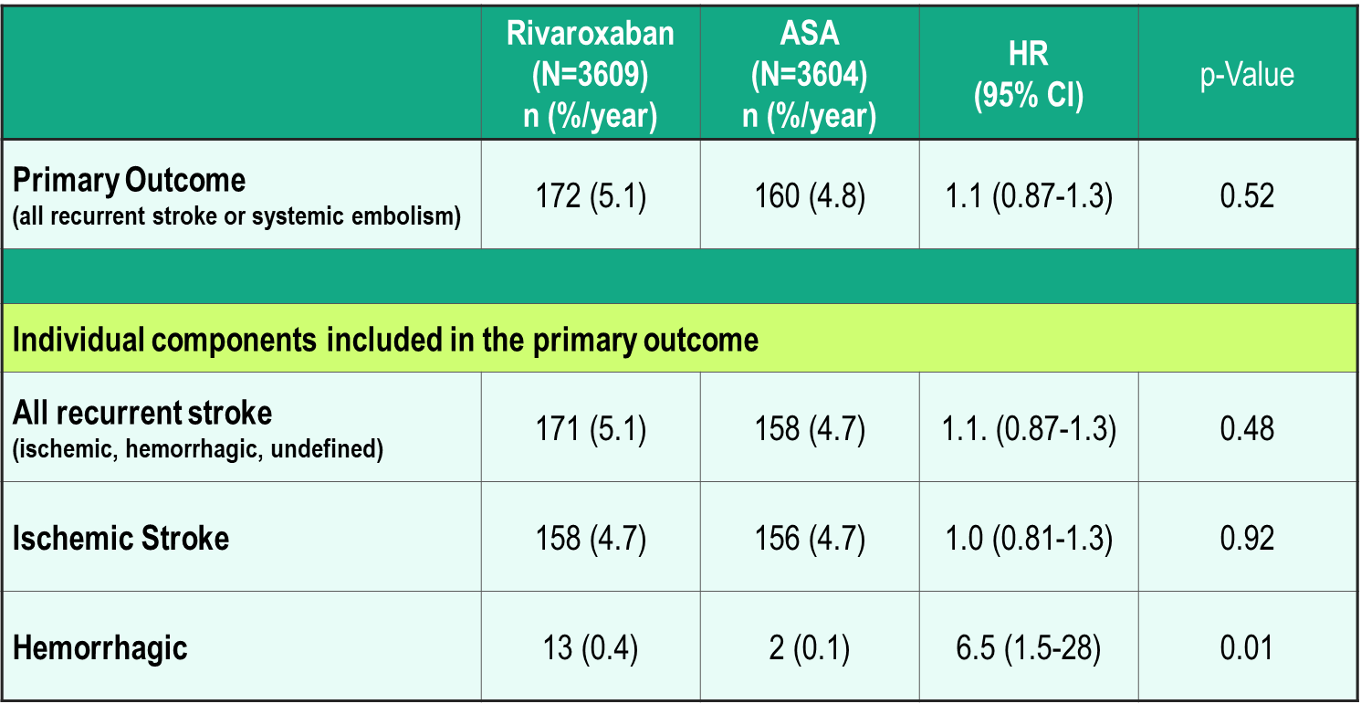
NAVIGATE ESUS Efficacy Outcomes
Hart RG et al. Rivaroxaban for Stroke Prevention after Embolic Stroke of Undetermined Source. N Engl J Med 2018; 378:2191-2201
Notes:
Speaker Notes:
The primary efficacy outcome of recurrent stroke of any type or systemic embolism occurred in 172 patients in the rivaroxaban group (annualized rate, 5.1%) and in 160 in the aspirin group (annualized rate, 4.8%) (hazard ratio, 1.07; 95% confidence interval [CI], 0.87 to 1.33; P=0.52). This represented 332 (74%) of the anticipated 450 efficacy events that were expected to occur in order for the trial to have adequate power. A total of 314 events (95%) were ischemic strokes, 158 of which occurred in the rivaroxaban group and 156 in the aspirin group (hazard ratio, 1.01; 95% CI, 0.81 to 1.26); 15 events (5%) were hemorrhagic strokes and 3 (1%) were systemic emboli. Of the 314 recurrent ischemic strokes, 36 (11%) were associated with symptoms lasting less than 24 hours but also with neuroimaging evidence of brain infarction, and 5 (2%) could not be classified as ischemic or hemorrhagic because brain imaging was not performed. There were 13 hemorrhagic strokes in the rivaroxaban group, as compared with 2 in the aspirin group. The severity of recurrent ischemic strokes as indicated by the modified Rankin scale score at hospital discharge was similar in the two treatment groups
High Stroke / SE event rate of 5%/year and ischemic stroke rate of 4.7%/year (equal in both groups).
Rivaroxaban 15 mg was unable to reduce this event rate vs. ASA 100mg, suggesting that undiagnosed PAF was not a major cause of recurrent stroke in this population.
In AVEROES, apixaban 5 mg bid (reduced to 2.5 mg bid when 2/3 “ABC” criteria met) was very effective at reducing the rate of stroke / SE. However AVEROES patients had documented AF.

Slide 25
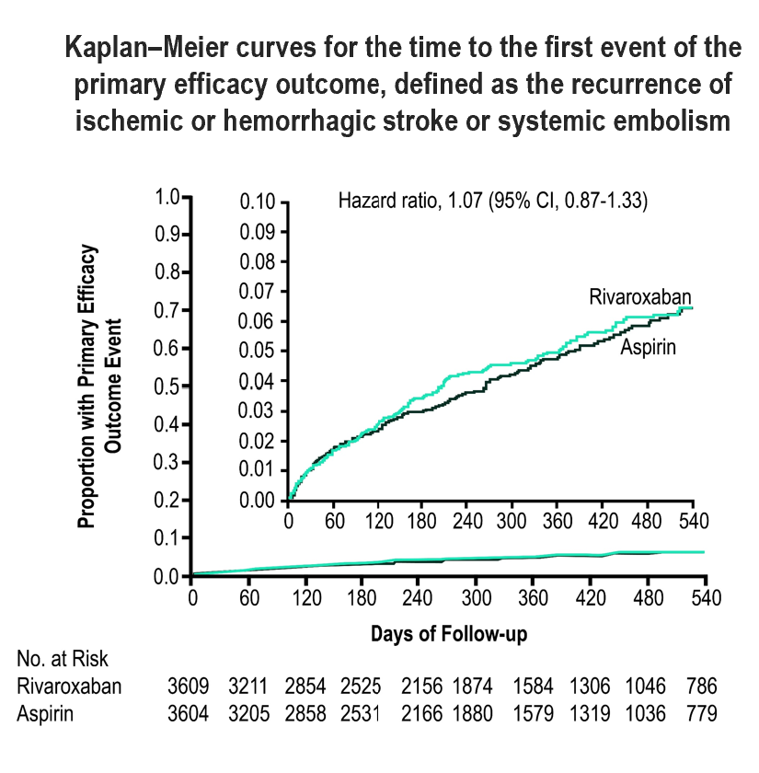
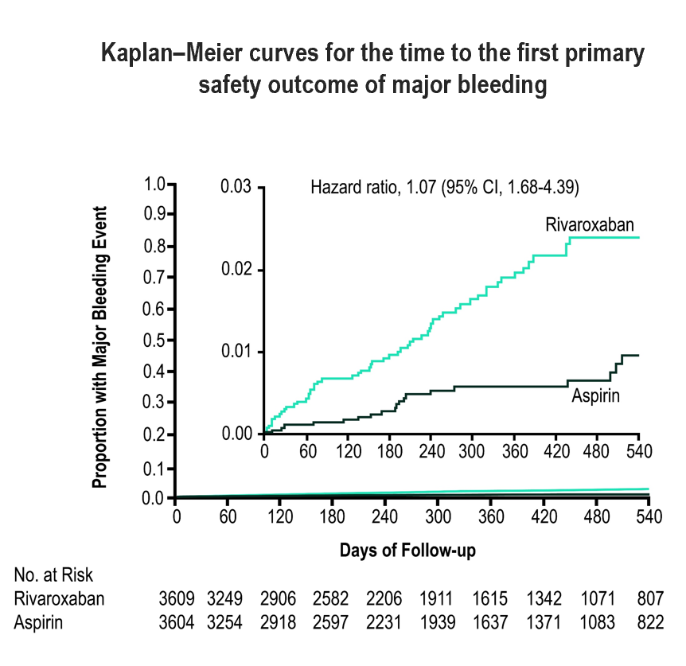
NAVIGATE ESUS Efficacy Outcomes
Insets show the same data on an enlarged y axis.
Hart RG et al. Rivaroxaban for Stroke Prevention after Embolic Stroke of Undetermined Source. N Engl J Med 2018; 378:2191-2201
Notes:
Speaker Notes:
Recurrent strokes in the Navigate-ESUS population may not, in fact, have been embolic or may have been due to heterogeneous embolic sources (e.g. arterial, cardiac or paradoxical via PFO) unresponsive to DOAC therapy.
The primary efficacy outcome of recurrent stroke of any type or systemic embolism occurred in 172 patients in the rivaroxaban group (annualized rate, 5.1%) and in 160 in the aspirin group (annualized rate, 4.8%) (hazard ratio, 1.07; 95% confidence interval [CI], 0.87 to 1.33; P=0.52). This represented 332 (74%) of the anticipated 450 efficacy events that were expected to occur in order for the trial to have adequate power. A total of 314 events (95%) were ischemic strokes, 158 of which occurred in the rivaroxaban group and 156 in the aspirin group (hazard ratio, 1.01; 95% CI, 0.81 to 1.26); 15 events (5%) were hemorrhagic strokes and 3 (1%) were systemic emboli. Of the 314 recurrent ischemic strokes, 36 (11%) were associated with symptoms lasting less than 24 hours but also with neuroimaging evidence of brain infarction, and 5 (2%) could not be classified as ischemic or hemorrhagic because brain imaging was not performed. There were 13 hemorrhagic strokes in the rivaroxaban group, as compared with 2 in the aspirin group. The severity of recurrent ischemic strokes as indicated by the modified Rankin scale score at hospital discharge was similar in the two treatment groups
High Stroke / SE event rate of 5%/year and ischemic stroke rate of 4.7%/year (equal in both groups).
Rivaroxaban 15 mg was unable to reduce this event rate vs. ASA 100mg, suggesting that undiagnosed PAF was not a major cause of recurrent stroke in this population.
In AVEROES, apixaban 5 mg bid (reduced to 2.5 mg bid when 2/3 “ABC” criteria met) was very effective at reducing the rate of stroke / SE. However AVEROES patients had documented AF.

Slide 26
RE-SPECT-ESUS (Embolic Stroke of Undetermined Source)
N=5390
Mean age 64 yrs (60% men)
Median F/U 19 months (event driven)
Rx: dabigatran 150 mg bid (110 mg bid if >75yo or ClCr 30-50 ml/min) vs ASA 100mg daily (75% pts received dabi 150 mg bid)
Primary efficacy outcome = any stroke (ischemic, hemorrhagic, unknown) : 4.1%/yr for dabi and 4.8%/yr for ASA (HR 0.85 NS)
Primary safety outcome = ISTH major bleed : 1.7%/yr for dabi and 1.4%/yr for ASA (HR 1.19 NS)
Results presented at the World Stroke Congress in Montreal – October 2018
Notes:
Speaker Notes:
Embolic Strokes of Undetermined Source (ESUS) are also known as “cryptogenic strokes” and represent about 20% of all ischemic strokes.
RE-SPECT-ESUS (BI) : Dabigatran Etexilate for secondary stroke prevention in patients with embolic stroke of undetermined source. (Preliminary results presented at the World Stroke Congress in Montreal – Oct 2018)
Median time from index stroke to randomization of 45 days
The 5,390-patient ESUS trial—called RE-SPECT ESUS—was designed to test whether dabigatran is superior to aspirin 100 mg a day for the prevention of recurrent stroke. Most patients in the dabigatran arm received 150 mg twice daily, but those 75 years and older and those with moderate renal impairment received the lower 110-mg dose.
Through a mean follow-up of 19 months, the rate of recurrent stroke (primary outcome) was 4.1% per year with dabigatran and 4.8% per year with aspirin, a nonsignificant difference (HR 0.85; P = 0.1). Van Ryn said the Kaplan-Meier curves showed increasing separation between groups, in favor of dabigatran, as follow-up progressed.
The rate of major bleeding was similar in both arms—1.7% per year with dabigatran and 1.4% per year with aspirin, van Ryn said. There were three fatal bleeds—all in the aspirin arm—during the trial.
The trial “provides insight into this concept of ESUS,” van Ryn said. “I don’t think you could say it was a failure for dabigatran. There was this hint of an improvement, and I think now it really provides a lot of excitement for the field to try and understand which patients may benefit from this and potentially refine the concept of ESUS and maybe find better treatments for these patients.”
However, there is NO current indication for Dabigatran for ESUS with no documented AF .
Another direct oral anticoagulant (DOAC), rivaroxaban (Xarelto; Bayer/Janssen), also failed to demonstrate a benefit in an ESUS population. Asked whether it’s still possible that DOACs could prove useful in this group of patients, Van Ryn said it’s too early tell.

Slide 27

Case 8
Francis
84 years old
Francis comes to see you for a routine check up
Francis has a pacemaker for sinus pauses and AV block
Notes:
Speaker Notes:

Slide 28


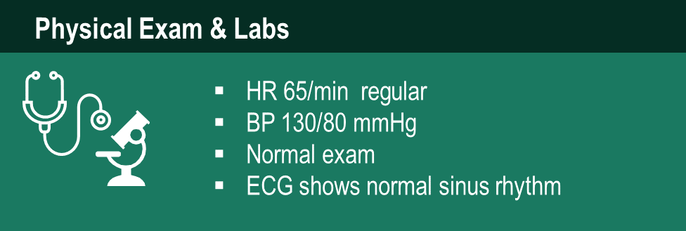
Case 8
Francis
84 years old
Notes:
Speaker Notes:

Slide 29
Case 8
Francis
84 years old
Pacemaker data logs for the prior 6 months show:
Atrium paced 40% of the time
Ventricle paced 20 % of the time
10 episodes of asymptomatic AF at 80/min
Longest AF episode is 5 hours
Notes:
Speaker Notes:

Slide 30
Would YOU prescribe a DOAC to Francis for AF detected min on interrogation of her pacemaker?
Notes:
Speaker Notes:
These questions are meant to engage the audience and evaluate what the audience would do in the described scenario

Slide 31
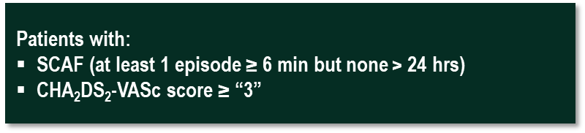
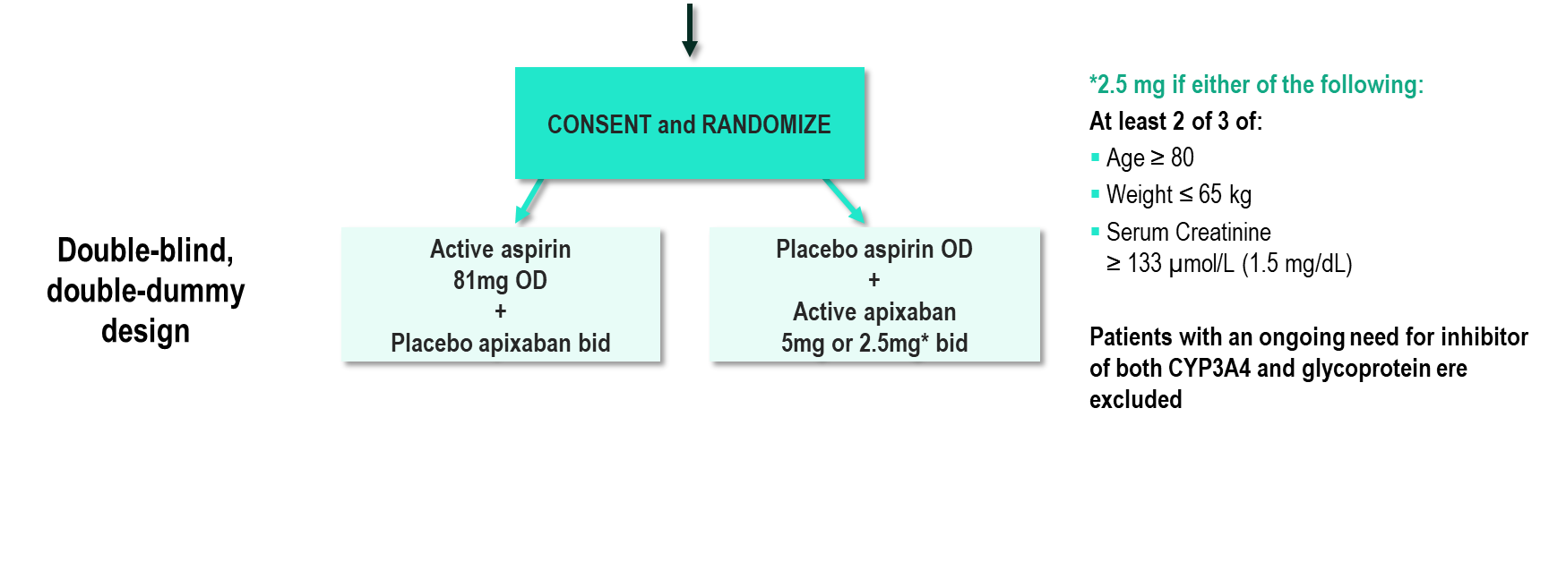
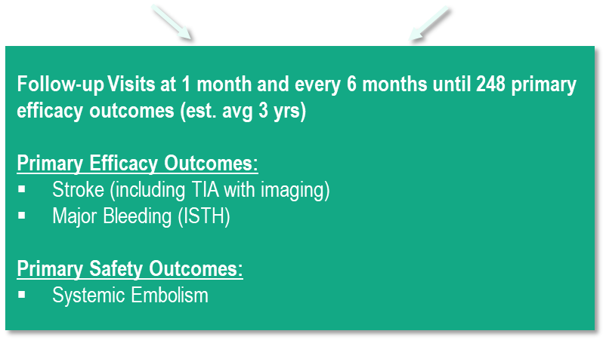
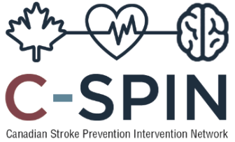
ARTESiA
Apixaban for the Reduction of Thrombo-Embolism due to Sub-Clinical Atrial Fibrillation
Lopes RD et al. Am Heart J. 2017 Jul;189:137-145. doi: 10.1016/j.ahj.2017.04.008. Epub 2017 Apr 24.
Notes:
Speaker Notes:
The only randomized trial addressing the issue of SCAF, stroke and anticoagulation is ongoing (ARTESiA; NCT01938248). In this trial, patients with device detected SCAF >6 min but <24 h and a CHA2DS2-VASc score >4 are being randomized to therapy with aspirin or apixaban. The goal is to enroll 4000 patients and results are expected in 2019.
To determine if treatment with apixaban, compared with aspirin, will reduce the risk of stroke and systemic embolism in patients with device-detected sub-clinical atrial fibrillation (SCAF) and additional risk factors for stroke. Current guidelines recommend treatment with oral anticoagulant for stroke prevention in clinical AF but opinion leaders are uncertain of the role of oral anticoagulants for patients with SCAF. 4000 patients from approximately 190 sites in Canada, USA and Europe will be randomized double-blind to receive apixaban (5mg bid or 2.5 mg bid as per labelling) or aspirin (81mg OD). The study will be event driven and will continue until 248 patients have experienced a primary outcome event (stroke or systemic embolism). Estimated mean follow-up time is 3 years.
ARTESiA: Rationale
Absolute stroke risk lower with SCAF Benefit of OAC may not be the same for SCAF as for AF (other causes of stroke) No temporal relationship between AF and stroke and no minimum AF duration Clinical practice divided IMPACT study stopped for futility Must consider risk-benefit ratio
Double-blind RCT of Apixaban vs. ASA Patients with at least one episode of SAF 6 minutes – 24 hours in duration, but no prior history of clinical AF or OAC use – CHADS-VASC score > 3 Primary outcome of stroke/NCNSE Total N=3917, to show 35% RRR
ARTESiA: Intervention
Double-blind, double-dummy Experimental – Apixaban 5 mg BID (2.5 mg BID in select patients) Control – ASA 80-100 mg OD ASA control as 60-70% of pacemaker clinic patients on ASA. Open-label ASA allowed, but discouraged.

Slide 32

2018 Focused Update of the
CCS AF Guidelines
RECOMMENDATIONS
It is reasonable to prescribe OAC therapy for patients who are aged 65 years or older or with a CHADS₂ score of 1 (CHADS-65) who have episodes of SCAF lasting > 24 continuous hours in duration.
Additionally, high-risk patients (such as those with a recent embolic stroke of unknown
source) with shorter-lasting episodes might also be considered for OAC therapy
(Weak Recommendation, Low-Quality Evidence).
Andrade JG et al. Canadian Journal of Cardiology 34 (2018) 1371e1392.
Notes:
Speaker Notes:

Slide 33

SCAF Detection Remaining Challenges and Uncertainties
Major remaining knowledge gaps
Temporal and causal relationship of SCAF to stroke
Thresholds for increased stroke risk (AF duration, burden, risk score) are unknown
Risks, benefits and cost of anticoagulation
Continuous versus intermittent anticoagulation
AF as a marker of stroke risk
Notes:
Speaker Notes:

Slide 34
Key Messages
Unrecognized AF appears very common
Particularly in the elderly and those with AF/stroke risk factors
Population-based AF screening may prevent stroke
Characterize the ideal population for extended rhythm monitoring
Determine the optimal definition of SCAF that warrants intervention
Empiric therapy of patients at risk of AF and stroke under evaluation
Evaluate whether intervention results in improved outcomes (i.e., how does initiation of oral anti-thrombotic therapy for SCAF influence the rate of stroke or systemic embolism during long-term follow-up?)
Notes:
Speaker Notes:

